Slide 1
Yogabar Assignment TASK – B (For BA Intern)
Anubhav Gaba
anubhavgaba@gmail.com

Slide 2
Our Product No. of Reviews and Avg Rating
The yearly average rating of our product saw a decline of 0.9% from 2019 to 2020
The yearly no. of reviews for our product also saw a similar decline of 31%

Slide 3
Our Product’s Monthly Average Rating
Monthly Average Rating | Column Labels
Row Labels | 2019 | 2020 | Grand Total
January | 4.333333333 | 4.47826087 | 4.44827586
February | 4.6 | 4.357142857 | 4.48275862
March | 4.414634146 | 4.107142857 | 4.28985507
April | 4.8125 | 2 | 4.36842105
May | 4.192307692 | 4.257142857 | 4.2295082
June | 4.36 | 4.475609756 | 4.44859813
July | 4.515789474 | 4.180555556 | 4.37125749
August | 4.396825397 | 4.5 | 4.4496124
September | 4.212765957 | 3.96 | 4.125
October | 4.325301205 |  | 4.3253012
November | 4.215686275 |  | 4.21568627
December | 3.75862069 |  | 3.75862069
Grand Total | 4.342052314 | 4.304597701 | 4.32662722
We can infer from the data presented here that we have received an average of 4.3 rating on Amazon which is pretty decent

Slide 4
Our Product’s Bad Rating Statistics
BAD RATING IS RATING LESS THAN 3
No. of Bad Ratings | Column Labels
Row Labels | 2019 | 2020 | Grand Total
January |  | 1 | 1
February |  | 1 | 1
March | 5 | 3 | 8
April |  | 2 | 2
May | 3 | 2 | 5
June | 3 | 8 | 11
July | 5 | 8 | 13
August | 7 | 3 | 10
September | 5 | 4 | 9
October | 9 |  | 9
November | 8 |  | 8
December | 9 |  | 9
Grand Total | 54 | 32 | 86
No. of Bad Ratings (Year wise)
Row Labels | Total Reviews
2019 | 497
2020 | 348
Grand Total | 845
We can infer from the data shown here that we have received an average of around 10 % bad reviews each year.

Slide 5
Our Product vs Competitor’s
Yearly Average Rating | Kellogs | Yogabar
2018 | 4.22
2019 | 4.17 | 4.34
2020 | 4.15 | 4.3
Ever since the inception of our product the competitor’s ratings on Amazon have been constantly declined at a rate of nearly 1% every year.
The first market year of our product saw a positive difference of 3.4% in average customer rating on Amazon

Slide 6
Our Product vs Competitor’s
The number of reviews for our product on Amazon is nearly 2 times that of our competitor’s
It has an overall 4% higher yearly average rating in both 2019 and 2020
Conclusion: Our product has a higher market share on Amazon as compared to our customer’s with better product quality

Slide 7
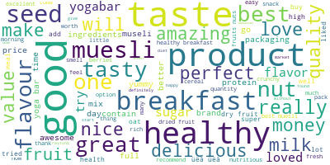
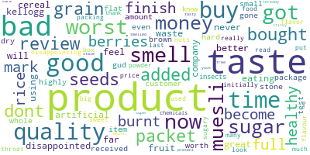
Our Product’s Review Word Cloud
Good Reviews
Bad Reviews

